Slide 1
Cybercrime Predictor System
System HACK!
CODERS ARM

Slide 2
Table of contents
01.
02.
03.
Dataset Information
Dataset Cleaning
Dashboard
04.
05.
Supervised Machine Learning
Unsupervised Machine Learning

Slide 3
01
Dataset Information

Slide 4
Dataset Information
GOAL
PROTOCOLS
COLLECTION TECHNIQUES
Measure the level of cybersecurity awareness of cybercrime in Saudi Arabia.
Saudi nationality.
Older than 18 years old.
University emails from 27 Saudi universities.
WhatsApp messages.

Slide 5
Dataset Information
Number of Records
Number of Questions
1 , 230
Saudi nationals have been recruited
31
Divided into 4 main parts
Number of Features
Year of Collection
66
Extracted from the answers
2019
Druing the period of Aug to Oct

Slide 6
“The Kingdom is keener to provide a secure environment for data and digital operations through a robust security system"

Slide 7
MISSION
VISION
Built a model to predict if the user will be a victim of cybercrime or not
Help the National Cybersecurity Authority in developing, implementing, and supervising their strategies.

Slide 8
02
Dataset Cleaning

Slide 9
Dataset Cleaning
01
02
03
04
05
Remove
Rows
Edit
Columns
Filling Missing Values
Splitting
Values
Encoding Categorical Values

Slide 10
Dataset Cleaning (Remove Rows)
Remove records that 20% or more of their features are missing.

Slide 11
Dataset Cleaning (Edit Columns)
CHANGE THEIR NAMES
Remove ‘?’ and numbers
Convert them to names
REMOVE LEADING AND TRAILING WHITESPACES
CONVERT BLANK VALUES TO NaN

Slide 12
Dataset Cleaning (Filling Missing Values)
01
02
03
04
Mode
Forward Technique
Backward Technique
Substitute from Another Column

Slide 13
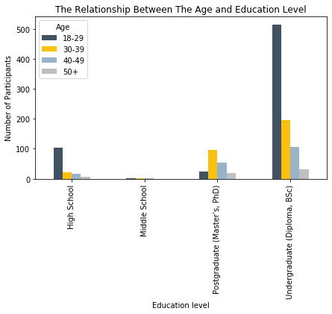
Filling Missing Values ( Mode )
1st
Calculate the mode per each education level.
2nd
Fill the missing ages based on education level.

Slide 14
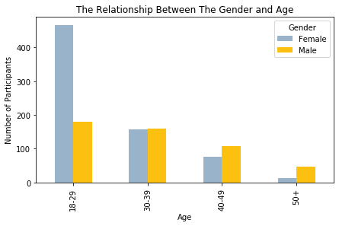
Filling Missing Values ( Mode )
1st
Calculate the mode per each range of ages.
2nd
Fill the missing gender based on age.

Slide 15
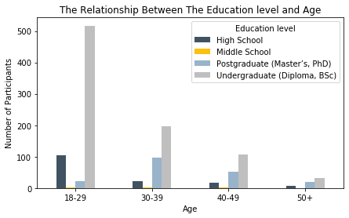
Filling Missing Values ( Mode )
1st
Calculate the mode per each range of ages.
2nd
Fill the missing education level based on age.

Slide 16
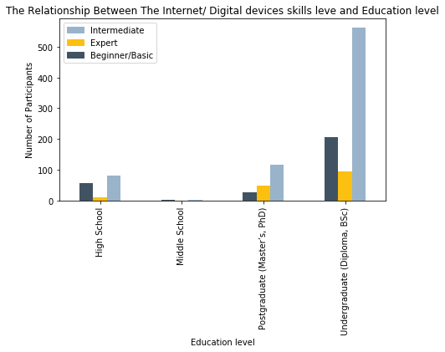
Filling Missing Values ( Mode )
1st
Calculate the mode per each education level.
2nd
Fill the missing skill level based on education level.

Slide 17
Filling Missing Values (Substitute from Another Column )
To who report cybercrime
Not victim, report cybercrime
To who report cybercrime
Specialist
Saudi CERT
Saudi CERT
No one
No one
No one
Saudi eGovernment Portal
Saudi eGovernment Portal
Police
Police
Police

Slide 18
Dataset Cleaning (Splitting Values)
Operating system of desktop or laptop
Windows 8
mac OS
Windows 10
Windows 8, mac OS
1
1
0
Windows 10
0
1
0

Slide 19
03
Dashboard

Slide 20
04
Supervised Machine Learning

Slide 21
Logistic Regression
 | training | testing
precision
recall
2
0.961856
0.958848
0.830508
1.0
3
0.961856
0.958848
0.830508
1.0
5
0.963918
0.958848
0.830508
1.0
10
0.963918
0.958848
0.830508
1.0
15
0.962887
0.958848
0.830508
1.0

Slide 22
Decision Tree Classifier
 | training | testing
precision
recall
2
0.961856
0.958848
0.830508
1.0
3
0.961856
0.958848
0.830508
1.0
5
0.967010
0.958848
0.830508
1.0
10
0.967010
0.958848
0.830508
1.0
15
0.967010
0.958848
0.830508
1.0

Slide 23
Random forest
 | training | testing
precision
recall
2
0.964948
0.954733
0.839286
0.959184
3
0.967010
0.962963
0.884615
0.938776
5
0.987629
0.946502
0.833333
0.918367
10
0.994845
0.958848
0.867925
0.938776
15
0.992784
0.958848
0.842105
0.979592

Slide 24
Support Vector Classifier
 | training | testing
precision
recall
2
0.961856
0.958848
0.830508
1.0
3
0.961856
0.958848
0.830508
1.0
5
0.961856
0.958848
0.830508
1.0
10
0.961856
0.958848
0.830508
1.0
15
0.961856
0.958848
0.830508
1.0

Slide 25
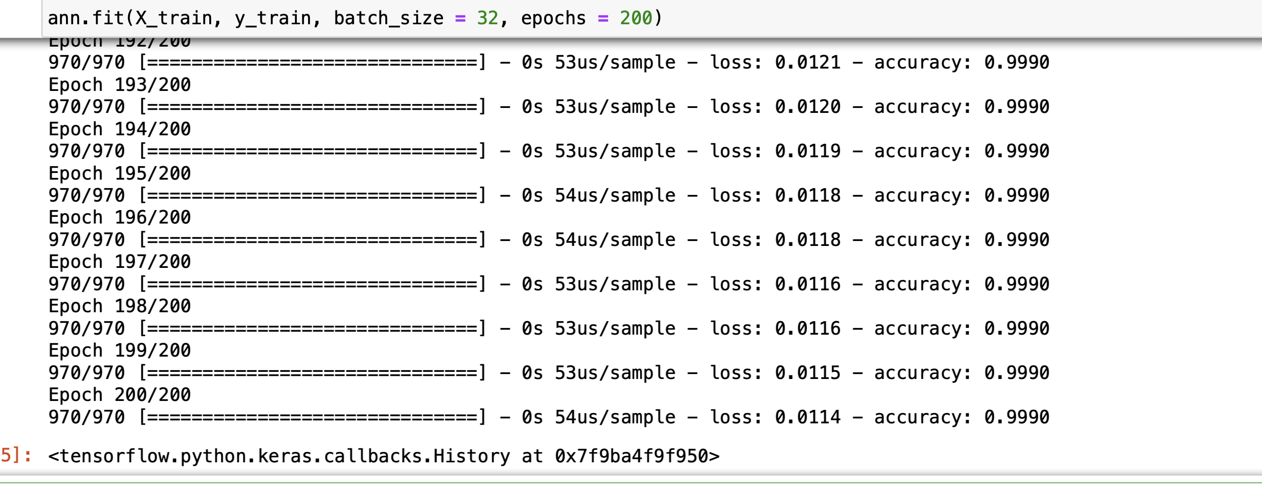
ANN (Artificial Neural Network)

Slide 26
05
Unsupervised Machine Learning

Slide 27
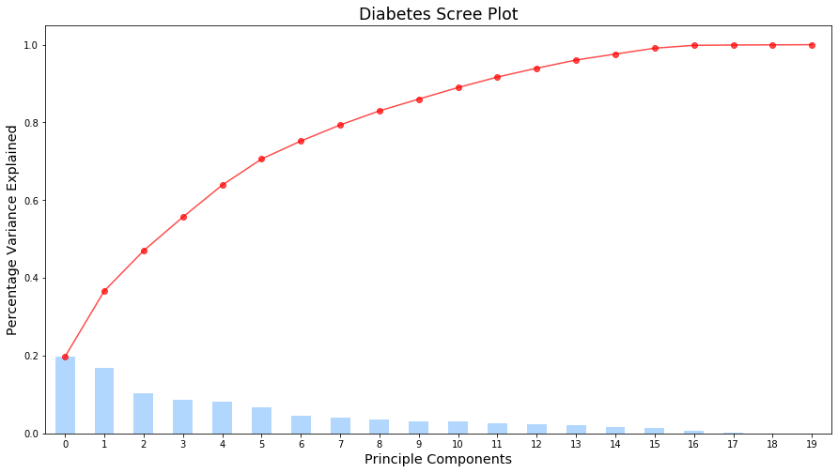
PCA
1st
Diabetes Scree Plot

Slide 28
PCA
Without PCA
With PCA
Training accuracy: 0.96
Testing accuracy: 0.95
Training accuracy: 0.94
Testing accuracy: 0.93

Slide 29
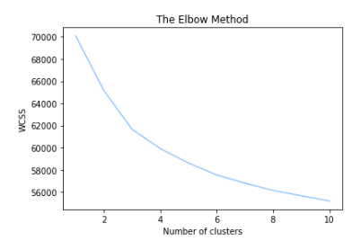
KMeans
1st
Elbow Graph

Slide 30
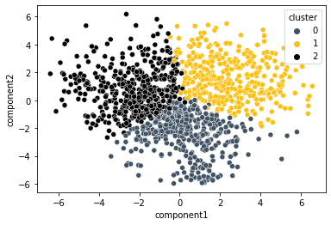
KMeans
2st
Create Three Clusters

Slide 31
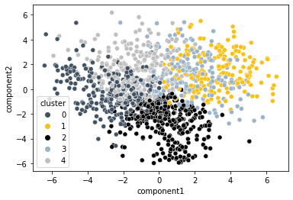
KMeans
3rd
Create Five Clusters

Slide 32
Thanks!
DANGER!

